Slide 1

Structures, Unions, Typedef
19CSE102 Computer Programming

Slide 2
Definition — Structure
A collection of one or more variables, typically of different types, grouped together under a single name for convenient handling
Known as struct in C
Like a class in Java but with no methods
Structures, Unions, and Typedefs

Slide 3
struct
Defines a new type
i.e., a new kind of data type that compiler regards as a unit
It is a derived datatype
E.g.,
struct student { float CGPA; //CGPA of students int age; //age of students int roll; //roll number of students
};
Members of the struct
A member of a struct is analogous to a field of a class in Java
Structures, Unions, and Typedefs

Slide 4
struct
Defines a new type
E.g.,
struct student { float CGPA; //CGPA of students int age; //age of students int roll; //roll number of students
};
Tag name of the structure
Note:– name of type is optional if you are just declaring a single struct

Slide 5
Declaring struct variables
struct student p, q, r;
Declares and sets aside storage for three variables – p, q, and r – each of type struct student
struct student stud[5];
Declares a 5-element array of struct student; allocates 5 units of storage, each one big enough to hold the data of one student.
struct student *st;
Declares a pointer to an object of type struct student.

Slide 6
Accessing Members of a struct
A dot operator(.) is used to access the members of the structure.
Let
struct student p; struct student stud[5];
Then
p.CGPA — is the CGPA of student p
p.age — is the age of student p
p.roll — is the roll number of student p
stud[i].CGPA — is the CGPA of the ith student
stud[i].age — is the age of the ith student

Slide 7
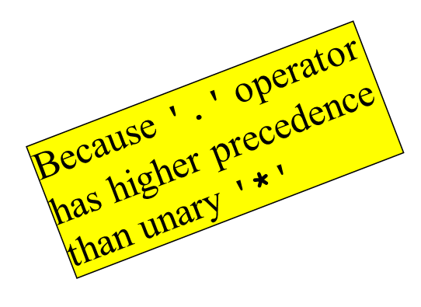
Accessing Members of a struct (continued)
Let
struct student *p;
Then
(*p).CGPA — is the CGPA of the student pointed to by p
(*p).roll — is the roll number of student pointed to by p
Why the parentheses?

Slide 8
Accessing Members of a struct (continued)
The (*p).member notation is a nuisance
Clumsy to type; need to match ( )
Too many keystrokes
This construct is so widely used that a special notation was invented, i.e.,
p->member, where p is a pointer to the structure

Slide 9
Previous Example Becomes …
Let
struct student *p;
Then
p->CGPA — is the CGPA of the student pointed to by p
P->roll — is the roll number of student pointed to by p

Slide 10
Operations on struct
Copy/assign
struct student p, q;
p = q;
Get address
struct student p;
struct student *s
s = &p;
Access members
p.age;
s -> roll;

Slide 11
Operations on struct (continued)
Remember:–
Passing an argument by value is an instance of copying or assignment
Passing a return value from a function to the caller is an instance of copying or assignment
E.g,:–
struct student f(struct student g) { struct student h = g;
...;
return h;
}

Slide 12
Initialization of a struct
Let
struct student { float CGPA; //CGPA of students int age; //age of students int roll; //roll number of students
};
Then struct student m = {8.9, 18, 1}; initializes the struct

Slide 13
Another note about structs
The following is not legal:–
struct student { float CGPA; //CGPA of students int age; //age of students int roll; //roll number of students
};
student m;
student *p;
You must write
struct student m;
struct student *p;

Slide 14
Arrays as members of structure
struct student { float CGPA; //CGPA of students int age; //age of students int roll; //roll number of students
char name[100]; // character array to store name of student
float marks[6]; // float array to store marks of 6 subjects for each student
};
student m;
scanf(“%s”,m.name); //reads the name of student m
for(i=0;i<6;i++)
scanf(“%f”, &m.marks[i]); // reads the marks of 6 subjects of student m

Slide 15
Typedef
Definition:– a typedef is a way of renaming a type
E.g.,
typedef struct student Students;
Students m, n;
Students *p, r[25];
Students read(Students m);
E.g., typedef, lets you leave out the word “struct”

Slide 16
typedef (continued)
typedef may be used to rename any type
Convenience in naming
Clarifies purpose of the type
Cleaner, more readable code
Portability across platforms
E.g.,
typedef char *String;
E.g.,
typedef int size_t;
typedef long int32;
typedef long long int64;

Slide 17
typedef (continued)
typedef may be used to rename any type
Convenience in naming
Clarifies purpose of the type
Cleaner, more readable code
Portability across platforms
E.g.,
typedef char *String;
E.g.,
typedef int size_t;
typedef long int32;
typedef long long int64;
These three may change from platform to platform
Defined once in a .h file!
Very common in C and C++
Esp. for portable code!

Slide 18
Revisit note about structs and pointers
The following is legal:–
/* in a .c or .h file */
typedef struct _item Item;
Item *p, *q;
… /* In another file */
struct _item {
char *info; Item *nextItem;
};

Slide 19
Unions
A union is like a struct, but only one of its members is stored, not all
I.e., a single variable may hold different types at different times
Storage is enough to hold largest member
Members are overlaid on top of each other
E.g.,
union Data {
int i;
float f;
char str[20];
} data;
It is programmer’s responsibility to keep track of which type is stored in a union at any given time!

Slide 20
Union (Continued)
The union tag is optional like structures.
Let
union Data{
int i;
float f;
char str[20];
}data;
Now, a variable of Data type can store an integer, a floating-point number, or a string of characters.
It means a single variable, i.e., same memory location, can be used to store multiple types of data.
Union Data will occupy 20 bytes of memory space because this is the maximum space which can be occupied by a character string.

Slide 21
Unions (continued)
unions are used much less frequently than structs — mostly
in the inner details of operating system
in device drivers
in embedded systems where you have to access registers defined by the hardware

